Slide 1
CSE 321
Real Time and Embedded Operating Systems
Project 3, Fall 2022
Timothy Erckert

Slide 2
Table of Contents
Introduction
Real World Concerns
Hardware Requirements
Software Requirements
Watchdog Timer
Synchronization Techniques
Bitwise Driver Control and Critical Section Protection
Threads and Interrupts
Block Diagram
Flowchart
Bill of Materials
Schematic
Building the System
Test Plan
Test Plan (continued)
Using the System
Future Considerations
Project Outcomes
Notes:
This slide needs to be removed for your final submission

Slide 3
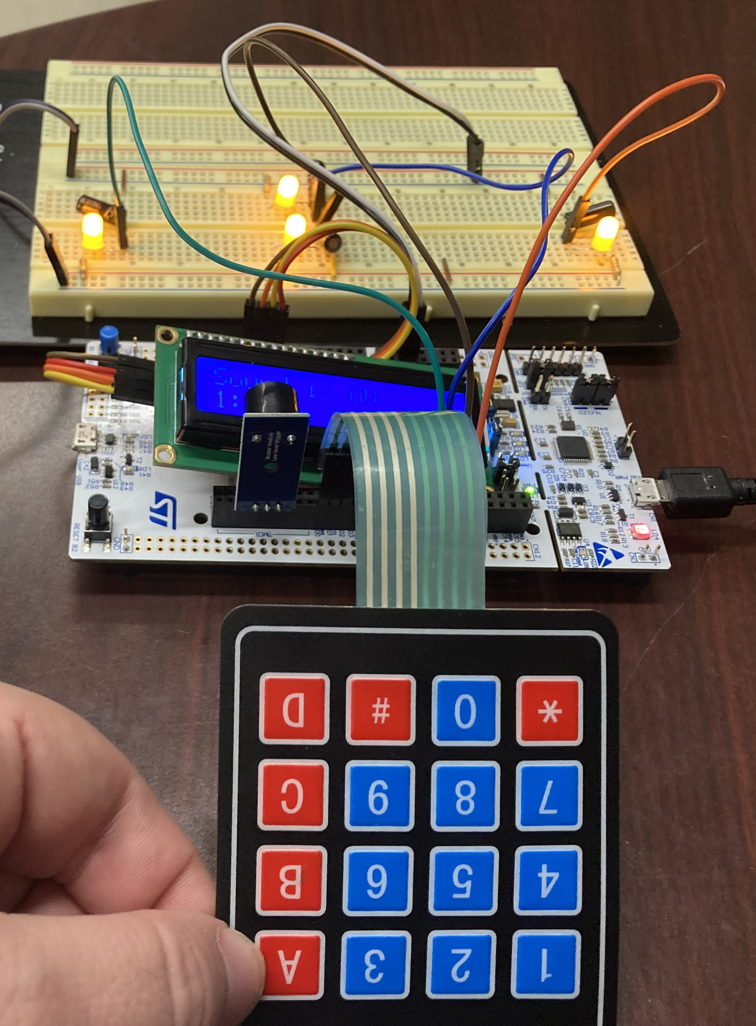
Introduction
This project aims to help people that have issues with fine motor control. It is a simple four-way digital level that uses auditory and visual cues to advise the user when a dip is detected and in which direction, allowing them to correct it and train their muscle memory. This can be coupled with placing the device on heavier objects that have a level top or on trays with objects that might fall over if skewed, allowing for further development as the user progresses in ability.

Slide 4
Real World Concerns
Safety concerns:
Use of the product should be started under the supervision of a professional
A user may attempt to advance too quickly on their own and, if weight is involved, may injure the muscles device is designed to train
There are no ethical concerns for this product.

Slide 5
Hardware Requirements
This project incorporates:
A 4x4 membrane keypad to manipulate the sound settings
An LCD to display current sound settings and menu options
4 tilt sensors bent in the four cardinal directions with respect to the board to detect dips
Four LEDs to provide visual feedback when device is skewed
A buzzer to proved auditory warning when tilt is detected

Slide 6
Software Requirements
The following software requirements are discussed in depth in the following slides:
A watchdog timer
Synchronization techniques
Bitwise driver control
Critical section protection
Threads

Slide 7
Watchdog Timer
Watchdog Timer
Forces the device to reboot if a critical section of code is not met within a specified timeframe
For this project, the timer allows 120ms between checks of whether buzzer should sound or not.
This spot was chosen since it is the main loop of the program and by default timer should be restarted every 10ms and must wait for access to a mutex that is shared with keypad interrupts through an EventQueue.
The amount 120ms was chosen because that is the maximum debouncing delay on keypad interrupts on rising and falling edges (50ms each) and the buzzer loop itself (10ms). Since it is not safety critical, an additional window of 10ms was added as a buffer.

Slide 8
Synchronization Techniques
Synchronization Techniques
An EventQueue was utilized for synchronization.
This allows inputs to push functions to a queue to be executed in the order that that they are received.
It also allows interrupts to “call” functions that it otherwise couldn’t. For example, functions with mutex.
The keypad interrupts use the event queue to push a function that changes the sound mode and prints to the LCD.

Slide 9
Bitwise Driver Control and Critical Section Protection
Bitwise driver control
Controlling a peripheral through direct register modification.
This is used to provide power to the LCD screen.
Critical section protection
Protects a spot in memory from being accessed for reading or modification by more than one thread at a time.
Mutexes were incorporated to protect sections that changed or used the value of the current sound mode to complete their tasks.

Slide 10
Threads and Interrupts
Threads
Threads allow for more than one function to happen simultaneously, either through dedicated hardware or function slicing by the OS.
Two threads are used in this project
An EventQueue thread used by keypad interrupts.
A buzzer thread that continuously updates whether the buzzer is on or off.
Interrupts
For this project, an interrupt is an external peripheral input that is handled via a dedicated function
They are utilized by the keypad to debounce rising and falling edges as well as pushing functions that change the sound mode to an EventQueue.

Slide 11
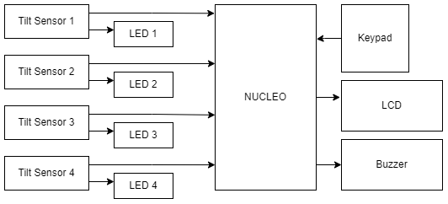
Block Diagram

Slide 12
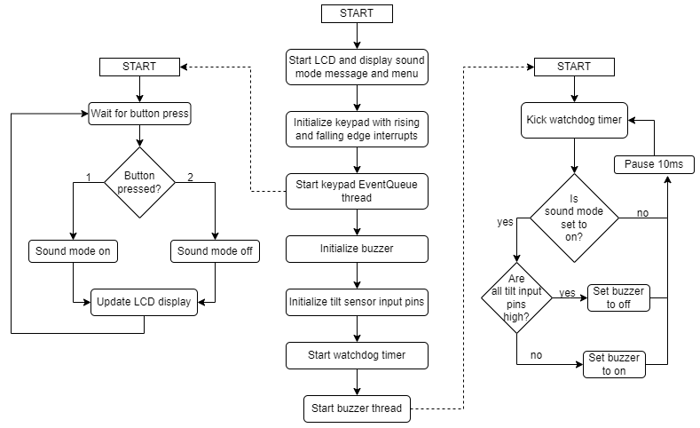
Flowchart
Notes:
Define the what, how, why kinda things. This is not where the result is, that comes after the feedback

Slide 13
Bill of Materials
Quantity | Item
1 | Nucleo STM32L4R5ZI
1 | 1602 LCD
4 | 100Ω resistors
4 | LEDs
1 | 4x4 membrane keypad
1 | Solderless breadboard
4 | Gikfun Metal Ball Tilt Shaking Position Switches
1 | Arceli Passive Low Level Trigger Buzzer Alarm
 | Female-to-male jumper wires
 | Male-to-male jumper wires
Notes:
This is where you will put comments on the approach you used to “fix my mess”. Consider what things you had to fix. Point out things

Slide 14
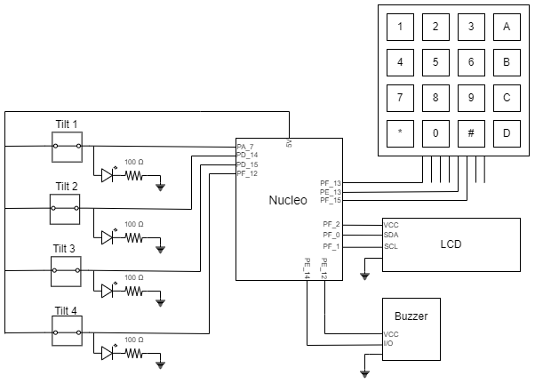
Schematic

Slide 15
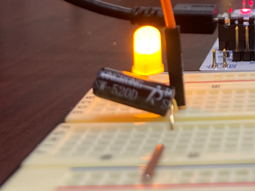
Building the System
Build the circuit following the documented schematic
*IMPORTANT* The tilt sensors should be tilted towards the direction that it should indicate. See image on slide. Adjust angle to meet desired tilt threshold.
A sensor should be given to each cardinal direction relative to the board.
Download the code files from GitHub
Compile using Mbed studio
You can either compile directly to your hardware or compile to binary and transfer to your Nucleo.
Example of tilt sensor bent in direction that tilt should be detected at. In this example, sensor detect dips to the west (left).
Notes:
This is where you will put comments on the approach you used to “fix my mess”. Consider what things you had to fix. Point out things

Slide 16
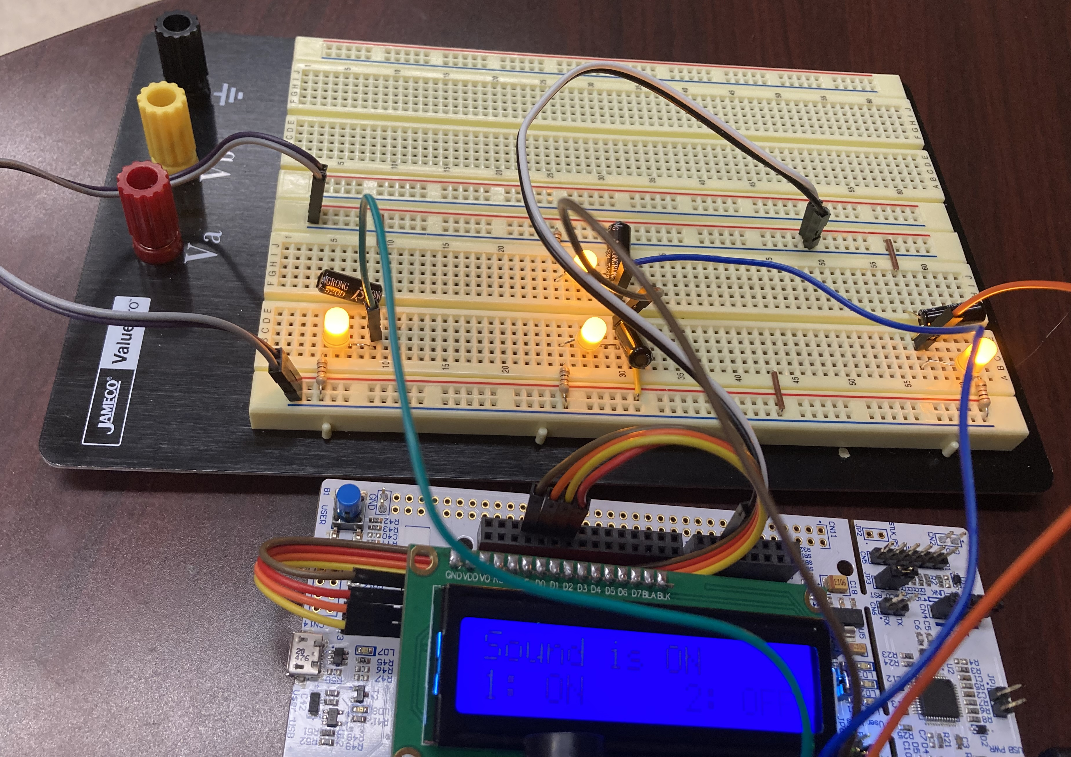
Test Plan
Building the circuit:
When voltage is supplied to the tilt sensor, LED should light up.
When tilting, LED should turn off
After compilation:
LCD should display sound menu/status
Removing a tilt sensor from breadboard should sound buzzer
Replacing sensor should turn off buzzer
Picture of built and compiled project with LCD menu display.
Notes:
This is where you will put comments on the approach you used to “fix my mess”. Consider what things you had to fix. Point out things

Slide 17
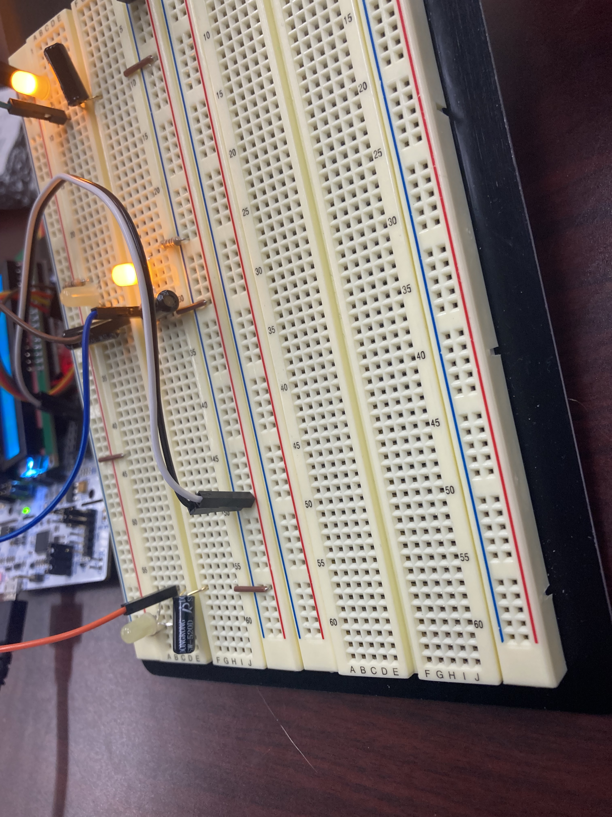
Test Plan (continued)
Holistic testing:
Keypad presses update LCD display to current sound mode
With a sensor removed, pressing 2 on keypad should silence buzzer. Pressing 1 will cause buzzer to sound again.
Tilting breadboard will cause light at lower angle to turn off and alarm to sound.
Returning to level state causes all LEDs to be lit and buzzer to turn off.
Example of completed project tilted. Direction of dip is forward and to the left. LEDs in direction of dip are off (picture cannot convey sound of buzzer).
Notes:
This is where you will put comments on the approach you used to “fix my mess”. Consider what things you had to fix. Point out things

Slide 18
Using the System
The system as currently designed can be used two ways to help reinforce or train fine motor skills:
A user can hold the breadboard and attempt to keep it level over an extended period.
The system can be placed on an item (such as a tray or container with a level top) and user can attempt to keep it level while holding or carrying the object for an extended period.
Notes:
This is where you will put comments on the approach you used to “fix my mess”. Consider what things you had to fix. Point out things

Slide 19
Future Considerations
The device, as it currently stands, is too bulky to be practical with extraneous peripherals. Future simplifications should involve the following:
Removal of LCD and keypad. Replacement with a toggle switch for sound.
A smaller STM board.
Replace current tilt sensors with a more accurate accelerometer or mercury-based tilt sensors to narrow the direction of dip for accuracy.
Battery pack integration for portability

Slide 20
Project Outcomes
This is the first project across courses where that feels like a hardware and software project. Until now it did not feel like computer engineering, it felt like writing software with extra steps.
When designing the circuit, the way the tilt sensor's function minimized how much software needed to be written for the main loop of the program. This really highlighted the ways a STM board could be an equal member of a project; microprocessors do not need to dominate a project for it to be functional. It, along with the keypad and LCD, could be easily replaced with a battery, a switch, and a 4-to-1 AND gate, for instance.
This revelation was the biggest source of growth for me and by far the most impactful part of the project.

